Slide 1


Oracle database
Lecture 39

Slide 2

Today’s Agenda
Loops In PL-SQL
Basic Loop
While Loop
For Loop

Slide 3
LOOPs In PL-SQL
PL-SQL provides the following types of looping statements
Basic Loop
While Loop
For Loop

Slide 4
Basic Loop
This loop statement is the simplest loop structure in PL/SQL.
The execution block starts with keyword 'LOOP' and ends with the keyword 'END LOOP'.
Syntax:
LOOP
statements;
EXIT WHEN condition;
END LOOP;

Slide 5
Basic Loop
This loop statement is the simplest loop structure in PL/SQL.
The execution block starts with keyword 'LOOP' and ends with the keyword 'END LOOP'.
Syntax:
LOOP
statements;
EXIT WHEN condition;
END LOOP;
LOOP
statements;
IF <condition> THEN
EXIT;
ENDIF
END LOOP;

Slide 6
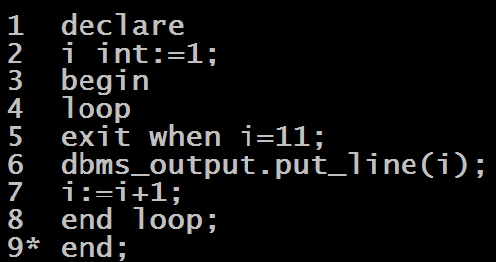
Program
WAP to display first 10 natural numbers

Slide 7
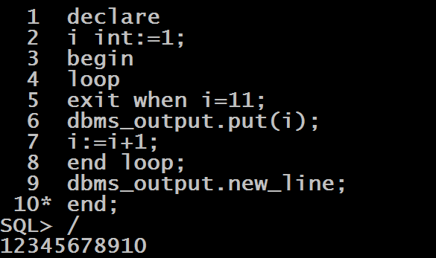
Program
WAP to display first 10 natural numbers

Slide 8
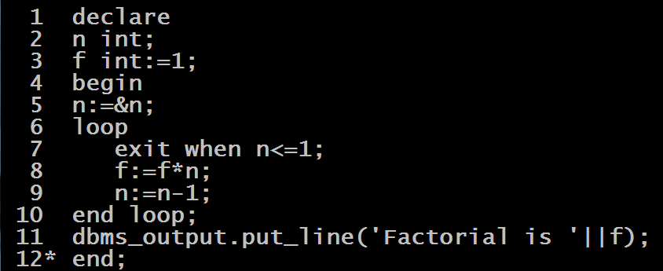
Program
WAP to accept an integer and calculate its factorial

Slide 9
The WHILE Loop
A WHILE LOOP statement in PL/SQL programming language repeatedly executes a target statement as long as a given condition is true.
Syntax:
WHILE condition LOOP
statements;
END LOOP;

Slide 10
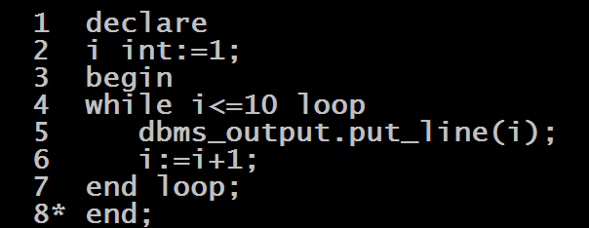
Program
WAP to print first 10 natural numbers using WHILE loop

Slide 11
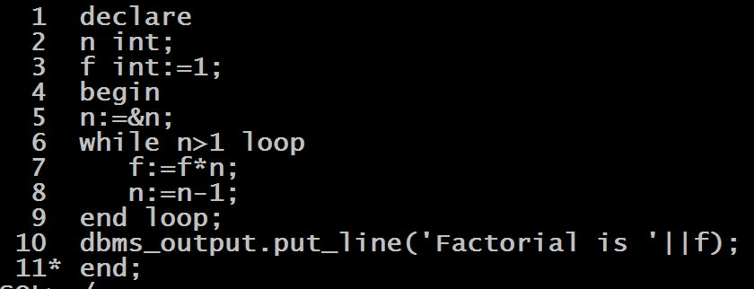
Program
Redesign the factorial program using WHILE loop

Slide 12
The FOR Loop
PL/SQL FOR LOOP executes a sequence of statements a specified number of times.
Syntax:
FOR index IN lower_bound .. upper_bound LOOP
statements;
END LOOP;

Slide 13
Important Points About FOR Loop
The index is an implicit variable.
It is local to the FOR LOOP statement.
In other words, we cannot reference it outside the loop.

Slide 14
Important Points About FOR Loop
Inside the loop, we can reference index but we cannot change its value.
After the FOR LOOP statement executes, the index becomes undefined.

Slide 15
Important Points About FOR Loop
The lower_bound and upper_bound are evaluated once when the FOR LOOP statement starts.
Their values are stored as temporary PLS_INTEGER values.
If we modify the values of lower_bound or upper_bound inside the loop, the change will have no effect because they are evaluated once only before the first loop iteration starts.

Slide 16
Important Points About FOR Loop
If index is less than upper_bound, index is incremented by one, the statements execute, and control again returns to the top of the loop.
When index is greater than upper_bound, the loop terminates, and control transfers to the statement after the FOR LOOP statement.
When lower_bound is greater than upper_bound, the statements do not execute at all.

Slide 17
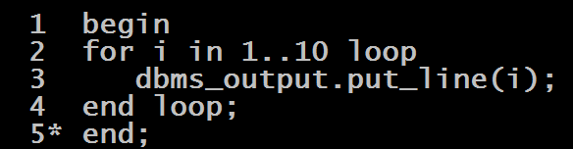
Program
WAP to print first 10 natural numbers using FOR loop

Slide 18
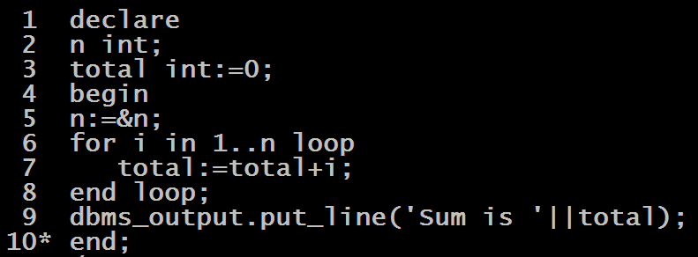
Program
WAP to calculate sum of first n natural numbers where n is to be taken from the user

Slide 19
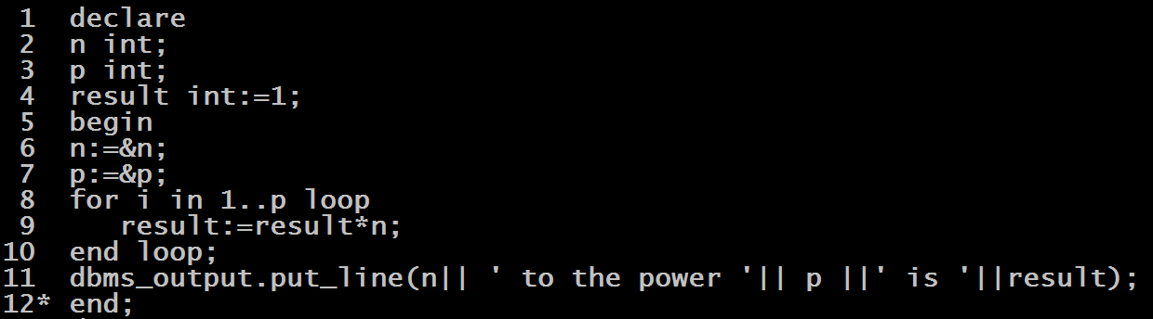
Program
WAP to calculate power of n to p , where n and p are to be taken from the user

Slide 20
Running FOR Loop In Reverse
The following shows the structure of the FOR LOOP statement with REVERSE keyword:
Syntax:
FOR index IN REVERSE lower_bound .. upper_bound LOOP statements;
END LOOP;
With the REVERSE keyword, the index is set to upper_bound and decreased by one in each loop iteration until it reaches lower_bound.

Slide 21
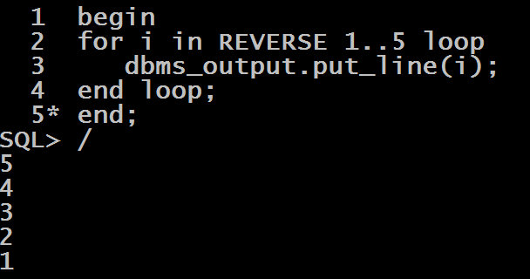
Example

